Slide 1
Atliq Hardware
AD-HOC insights
Atliq Hardwares (imaginary company) is one of the leading computer hardware producers in India and well expanded in other countries too.
However, the management noticed that they do not get enough insights to make quick and smart data-informed decisions.There are 10 ad hoc requests for which the business needs insights.
Objective- To provide business insights to the top management.

Slide 2
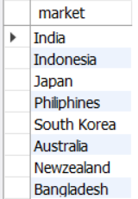
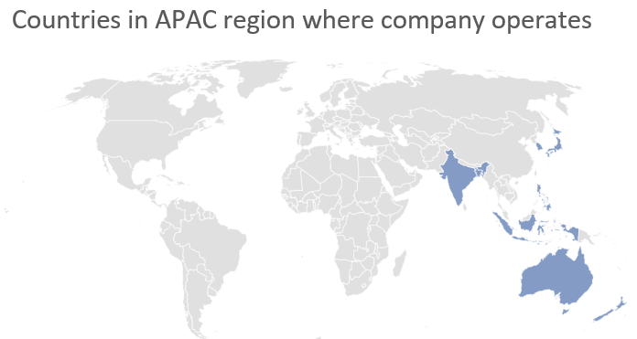
Request-1 Provide the list of markets in which customer "Atliq Exclusive" operates its business in the APAC region.
Insights-The company operates in 6 asian countries which are India, Indonesia, Japan, Philippines, South Korea,Bangladesh,two countries in oceania continent which are Australia and New Zealand.

Slide 3

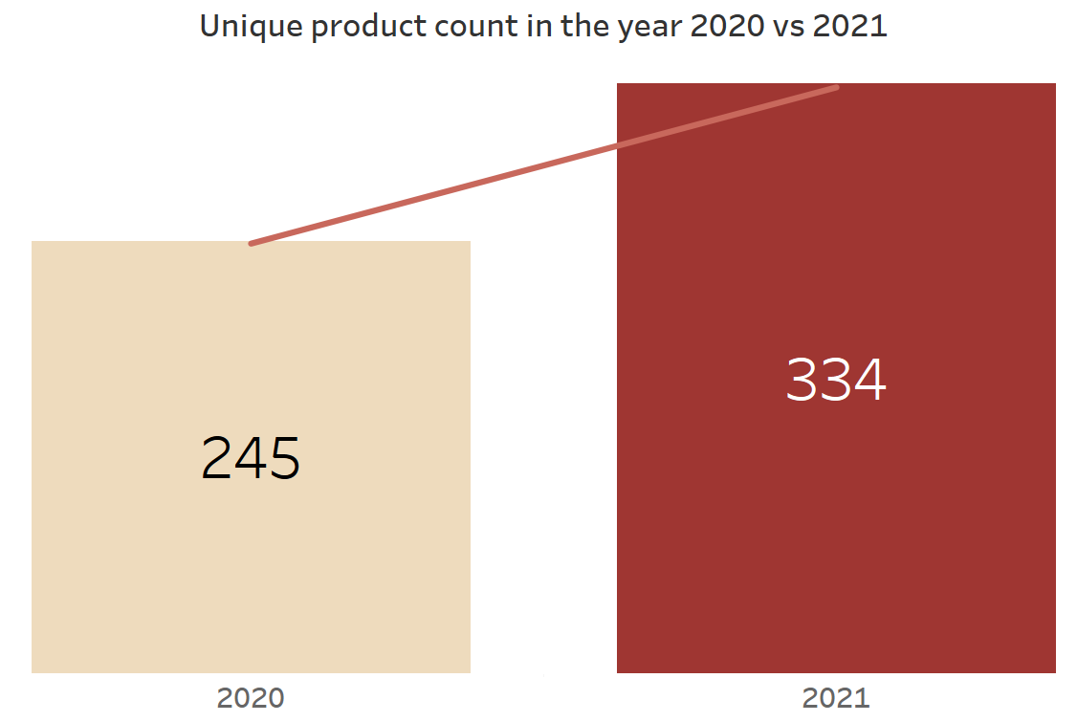
Request-2 What is the percentage of unique product increase in 2021 vs. 2020?
Insights-The total number of unique products produced by the company increased by nearly 36 percent to 334 in the year 2021 from 245 in the year 2020.

Slide 4
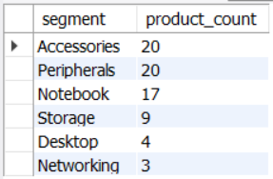
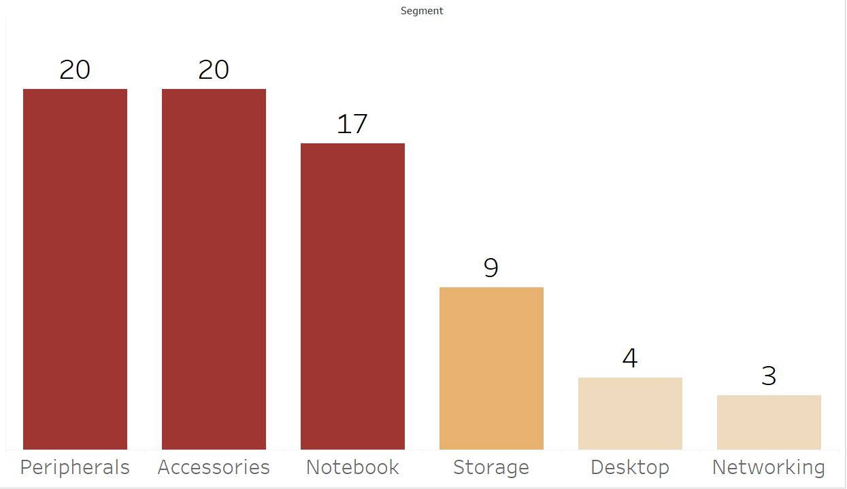
Request 3: Provide a report with all the unique product counts for each segment and sort them in descending order of product counts.
Insights- The company predominantly sells products in three categories which are Accessories,
Peripherals and Notebook.

Slide 5
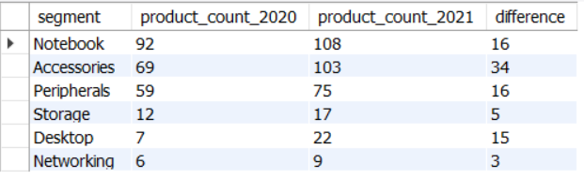
Request-4: Follow-up: Which segment had the most increase in unique products in 2021 vs 2020?
Insights- In the year 2021,the company focussed the most on the Accessories segment. There was a significant percentage change in the number of products in the Desktop category.

Slide 6
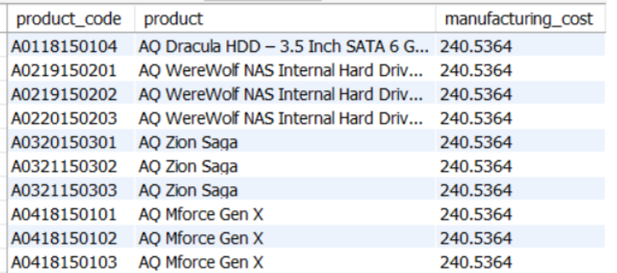
Request 5: Get the products that have the highest and lowest manufacturing costs.
Products which has the highest manufacturing cost

Slide 7
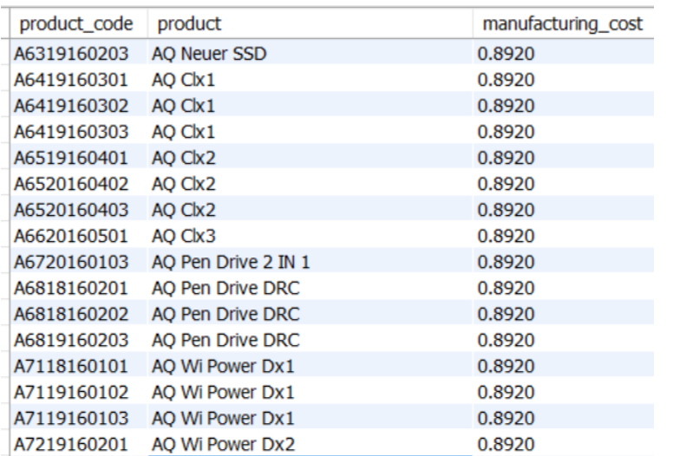
Request 5: Get the products that have the highest and lowest manufacturing costs.
Products which have low manufacturing costs
Insights- The highest manufacturing cost was 240.5364(347 products) and the lowest is 0.8920(347 products)

Slide 8
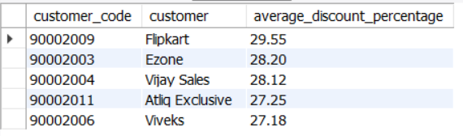
Request-6: Generate a report which contains the top 5 customers who received an average high pre_invoice_discount_pct for the fiscal year 2021 and in the Indian market.
Insights-Top 5 customers received on average more than 27% discount with flipkart receiving the highest discount at 29.55%.

Slide 9
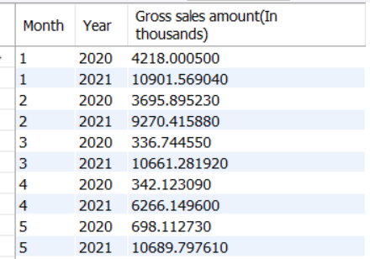
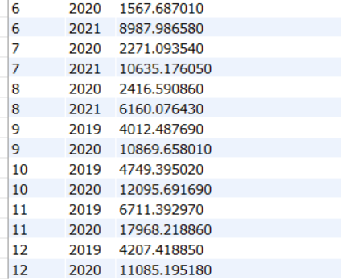
Request-7: Get the complete report of the Gross sales amount for the customer “Atliq Exclusive” for each month. This analysis helps to get an idea of low and high-performing months and take strategic decisions.

Slide 10
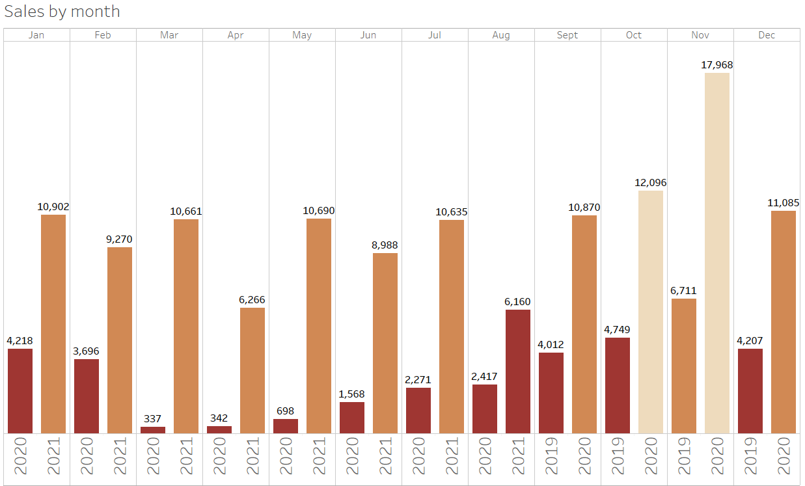
Request-7: Get the complete report of the Gross sales amount for the customer “Atliq Exclusive” for each month. This analysis helps to get an idea of low and high-performing months and take strategic decisions.
Insights- There was a significant increase in sales every year from 2019 to 2021. The last three months of the year October, November and December had the highest sales for the company.

Slide 11
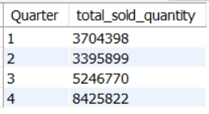
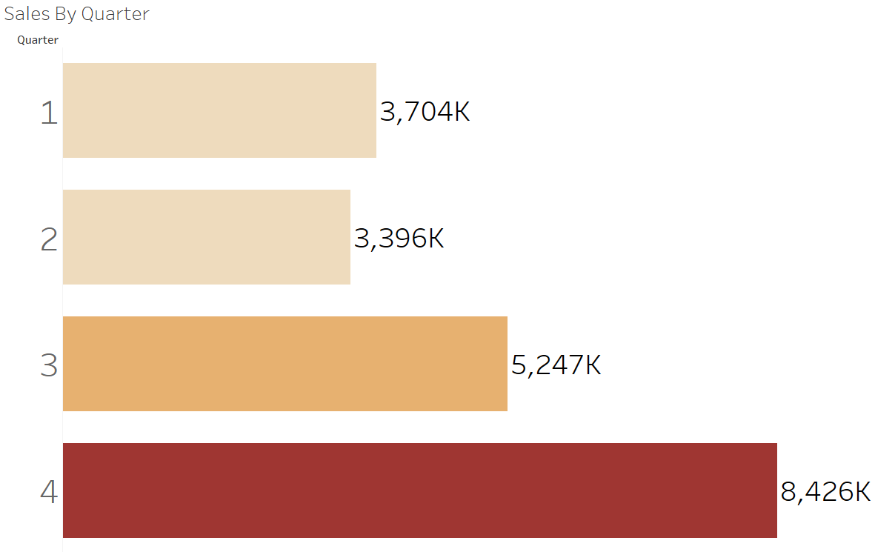
Request-8: In which quarter of 2020, got the maximum total_sold_quantity?
Insights- The company sold the most units of their products in the quarter 4 which was even more than the quarter 2 and quarter 1 sales combined.

Slide 12
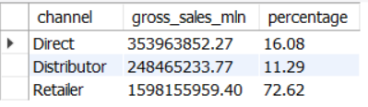
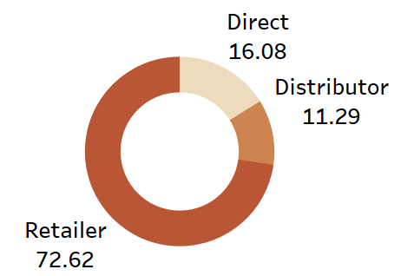
Request-9: Which channel helped to bring more gross sales in the fiscal year 2021 and the percentage of contribution?
Insights- Approximately three-fourth of the total sales amount was earned through the Retailers only.

Slide 13
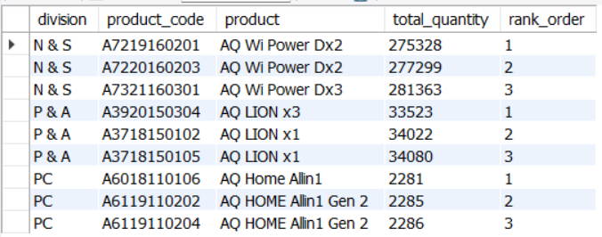
Request-10: Get the Top 3 products in each division that have a high total_sold_quantity in the fiscal_year 2021? The final output contains these fields, division product_code product total_sold_quantity rank_order
Insights- AQ Wi Power Dx2 is the most popular product from the N & S division, AQ LION x3 is the most popular product coming from P & A and AQ Home Allin1 is the highest selling product coming from PC division.

